Slide 1
Dynamic analysis of planar mechanical system with clearance joints using a new nonlinear contact force model Xupeng Wang, Geng Liu and Shangjun Ma Journal of Mechanical Science and Technology 30 (4) (2016) 1537~1545
Assignment 2 : ME 748 Computer Aided Simulation of Machines | Prof. Anirban Guha
Presented by : Deepak Kumar Thakur (213101001)
Link for paper: https://inis.iaea.org/search/search.aspx?orig_q=RN:47084707

Slide 2
Outlines
Introduction
Need for this model
What’s considered and not considered (New Nonlinear Contact force model)
Hertz Model And various development of contact law
New nonlinear contact force model
Comparison of new model with different other model and experimental values
Conclusion

Slide 3

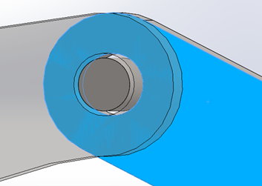
1. Introduction
Mechanical systems consist of Kinematic joints with
inevitable clearances.
With the demand of relative motions, clearance
joints have many effects on mechanical
system such as vibration, wear and noise
Reduces system reliability, kinematic accuracy and stability, even the life of mechanism
Hence modelling of an accurate contact force model for dynamic simulation of mechanical system with clearance joints is critical

Slide 4
2. Need for this model
Various contact force model proposed but all these models are purely elastic and do not consider the energy dissipation during contact process.
This drawback was solved using different models based on Hertz’s contact force models.
But these modified models works well for larger coefficient of restitution
( C_{r} ≥ 1 )

Slide 5
3. What’s considered and not considered
Flexibility of links
Lubrication action in the clearance joint
Plastic deformation in the clearance joint
A nonlinear contact law with nonlinear contact stiffness
Frictional effect measured by modified Coulomb friction

Slide 6

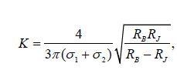

4. Hertz Model
Hertz contact law is a purely elastic contact force
It does not account for the energy dissipation during
the impact process
K - Generalized stiffness parameter,
n - Nonlinear power exponent (1.5 for metallic contact)
Δ - Relative deformation depth.
RB and RJ - Radius of bearing and journal
σ_{i} - Material parameter
υ_{i} - Poisson’s ratio
E_{i} - Young’s modulus associated with journal and bearing

Slide 7
4. Various development of contact law
MODEL | CONTACT FORCE MODEL
Hunt and Crossley | Pure elastic Hertz's law, combined with a nonlinear viscoelastic element
Lankarani and Nikravesh | Based on Hunt and Crossley work, Frequently used contact force model
Bai et al. | A new hybrid contact force model, based on the Lankarani- Nikravesh model and the improved Winkler elastic foundation model,
Wang and Liu | Based on the contact force model of Liu et al. [7] and contact force model of Lankarani and Nikravesh
*** These modified models works well for larger coefficient of restitution ( C_{r} ≥ 1 )

Slide 8




5. New nonlinear contact force model
K_{i} - Improved Generalized nonlinear stiffness coefficient,
Improved damping coefficient
Improved nonlinear contact force model
Modified Coulomb friction force model to depict the friction effect in clearance joint
c_{f} - friction coefficient
FN - Normal force
VT - Relative tangential velocity
c_{d} -Dynamic correction coefficient

Slide 9
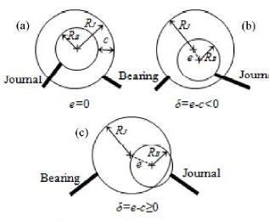
5. New nonlinear contact force model

Slide 10
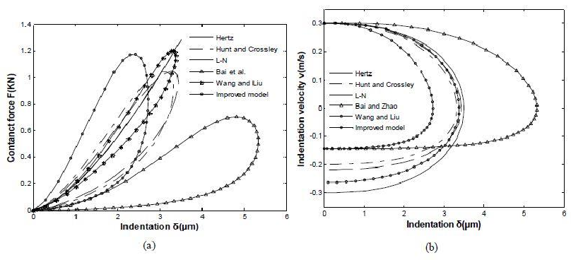
6. Comparison of new model with different other model and experimental values
Fig. (a) Force-indentation relation; (b) velocity indentation relation for different contact force models
For journal and bearing

Slide 11
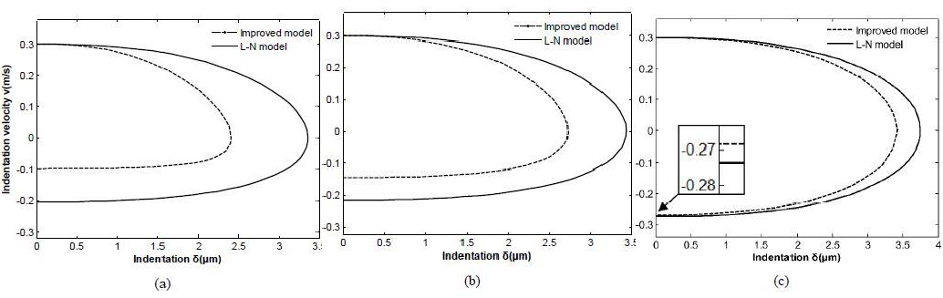
6. Comparison of new model with different other model and experimental values
Fig. Velocity-indentation curves with improved model and Lankarani and Nikravesh models: (a) C_{r} = 0.3; (b) C_{r} = 0.5; (c) C_{r} = 0.9.

Slide 12
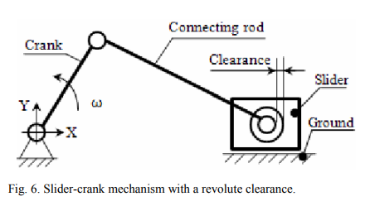
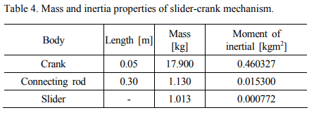
6. Comparison of new model with different other model and experimental values
Application Case : Slider crank mechanism

Slide 13
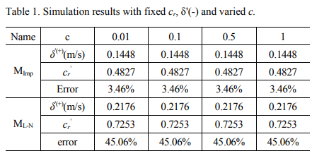
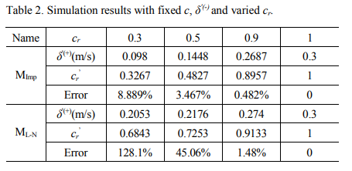
6. Comparison of new model with different other model and experimental values

Slide 14
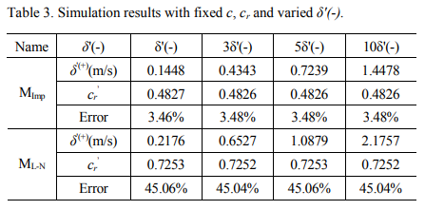
6. Comparison of new model with different other model and experimental values

Slide 15
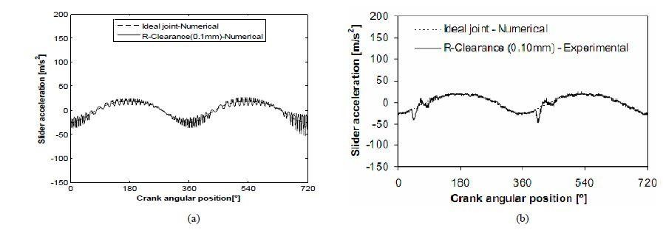
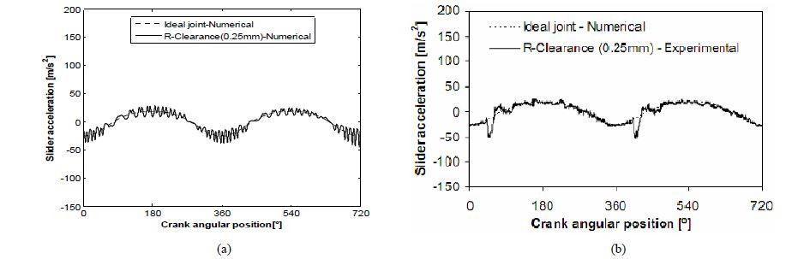
Fig. Slider accelerations with clearance size c = 0.1 mm (top) and c = 0.25 mm (bottom) from (a) simulation; (b) experiment

Slide 16
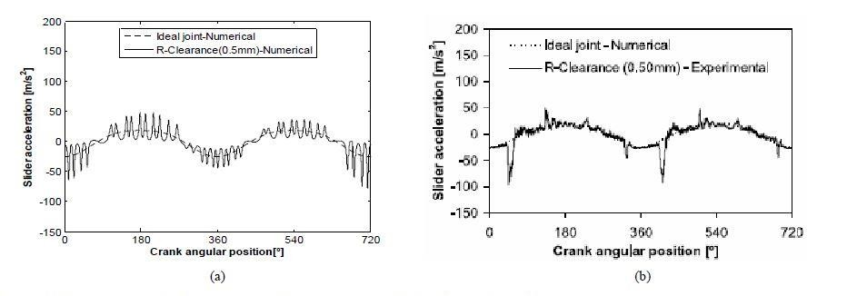
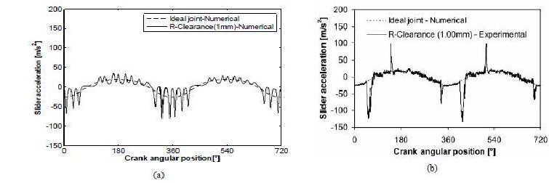
Fig. Slider accelerations with clearance size c = 0.5 mm (top) and c = 1 mm (bottom) mm from (a) simulation; (b) experiment

Slide 17
7. Conclusion
Reasons for the small difference in experimental and new model values
The clearance size is assumed to be equal and without change during simulation
Small variations on restitution and friction coefficient during simulation
the flexibility of links, and lubrication action and the plastic deformation in the clearance joint
Neglected in the numerical simulations which explains
A combination of a nonlinear contact law with nonlinear contact stiffness
The dynamic response of slider acceleration using new nonlinear contact force model is similar to the experimental results published and has least error for C_{r} ≤ 1.

Slide 18
Thanks!
Any question?
You can find me at:
213101001@iitb.ac.in
All references from https://inis.iaea.org/search/search.aspx?orig_q=RN:47084707

